Slide 1


Postman
Student
Expert

Slide 2


Agenda
1
Guided session in Postman
2
Template completion
3
Additional topics
4
Certification!
5
Student program participation
postman.com

Slide 3

Topics
The Postman Student template covers the following topics:
Requests and responses
Addresses, methods, query / path parameters, authorization, body data
Variables
Declaring and referencing in collections and environments
Collections
Adding descriptions for documentation
Scripts
Test assertions on response elements
Setting variables from scripts, passing data between requests
Running collections
Changing request execution order with scripts

Slide 4
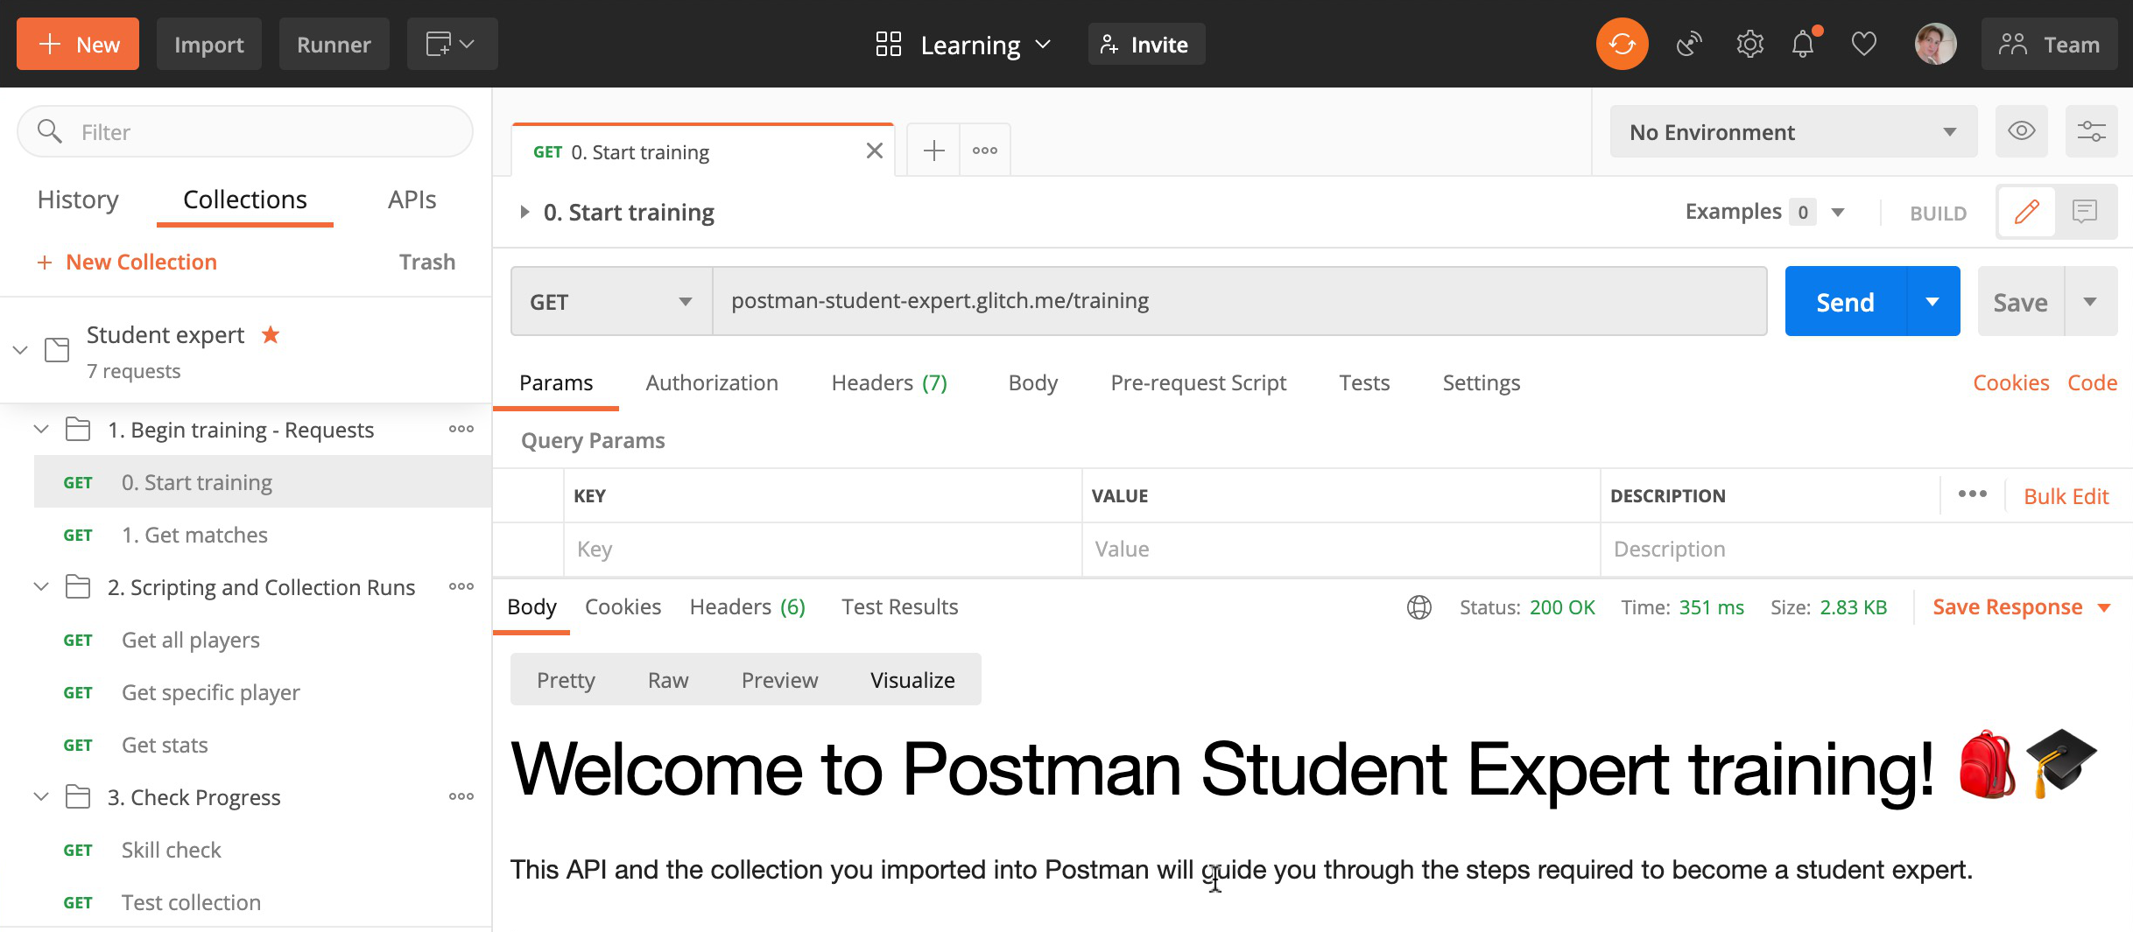
Workspace
Log into Postman and import the Postman Student Expert template:
Vsit bit.ly/student-workspace in your browser and fork the Student Expert Collection
Once you have the forked the collection, open it from Collections on the left of Postman, open the first folder and request 0. Start training and hit Send.
The responses will guide you
through next steps!
Notes:
Jump into Postman and work through the template

Slide 5
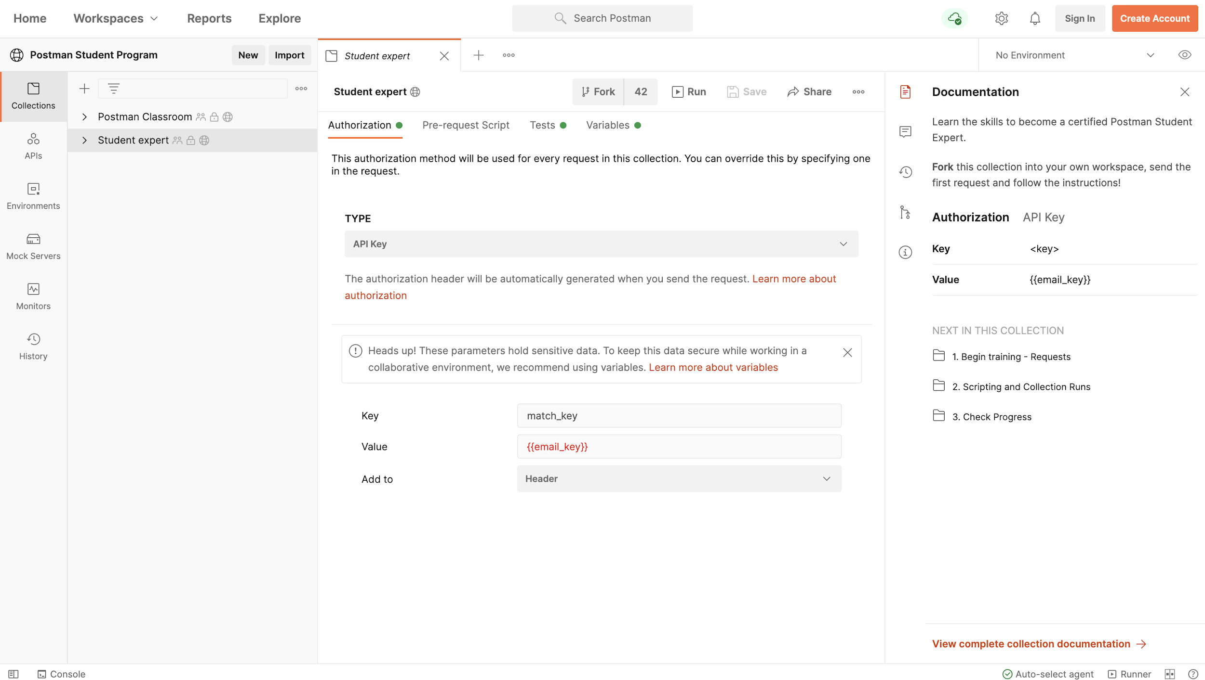
Fork Demo
Notes:
Navigate to the url and show them the demo or just show this screenshot.

Slide 6

Certification eligibility
Once your collection is completed you are welcome to submit it and become a certified Postman Student Expert!
You’ll receive:
An Open Badge that you can display all over the web
A Discourse badge you can display on your Postman community forum profile
👏 🏆 🚀
You’ll also be eligible to continue to the next stage of
the Postman student program

Slide 7

Completion requirements
Learners are eligible to receive Postman student expert certification by:
Completing the steps in the Postman Student Expert Workspace
The final request runs tests on the collection to check if it’s complete
Instruct Students to forward the completed collection link via the submission form
bit.ly/student-expert-submission
When the Postman team receives a collection link they will check it and hopefully award Postman Student Expert certification!

Slide 8

Support
Anyone need help completing their template?
Shout out or post a question:
If you’re stuck with the template
If you’d like more detail on anything covered
You can also use the Postman forum:
community.postman.com
Use the Category #training

Slide 9

Additional topics
Additional topics you might also like to learn about:
Mock servers
Using mock data in your requests
Monitors
Scheduling collection runs
Visualizations
Building response data into e.g. charts
Collaboration
Including version control
Notes:
Learning center links:
Mocks https://learning.postman.com/docs/designing-and-developing-your-api/mocking-data/setting-up-mock/
Monitors https://learning.postman.com/docs/designing-and-developing-your-api/monitoring-your-api/intro-monitors/
Visualizations https://learning.postman.com/docs/sending-requests/visualizer/
Collaboration https://learning.postman.com/docs/collaborating-in-postman/collaboration-intro/

Slide 10

Support
community.postman.com
Forum - use #training tag
learning.postman.com
Learning Center
explore.postman.com
API Network

